Slide 1
Data
Tomas Karpati MD
tc.datascience@gmail.com
054-2002430

Slide 2
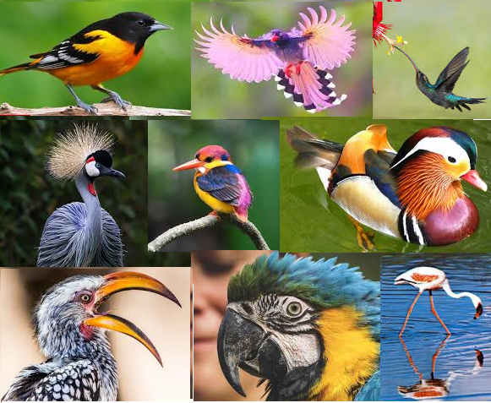
Data
Data comes from observation
Qualitative (description, can’t be measured)
Quantitative (can be measured or calculated)
Quality of the data
Subjective
Objective
Collection of data
Unstructured (can’t be encoded)
Structured (can be encoded)

Slide 3
Data Measurement
The earliest recorded systems of weights and measures originate in the 3rd or 4th millennium BC

Slide 4
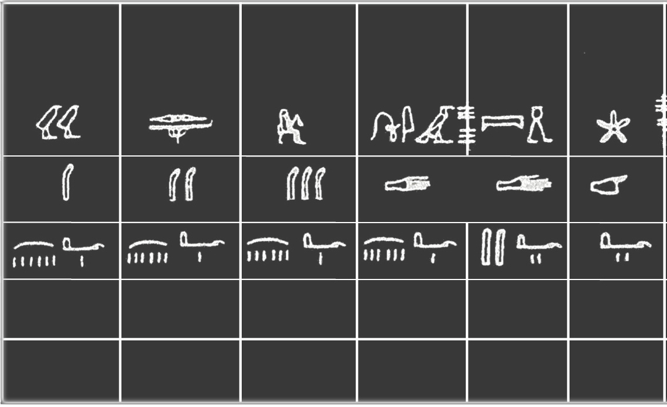
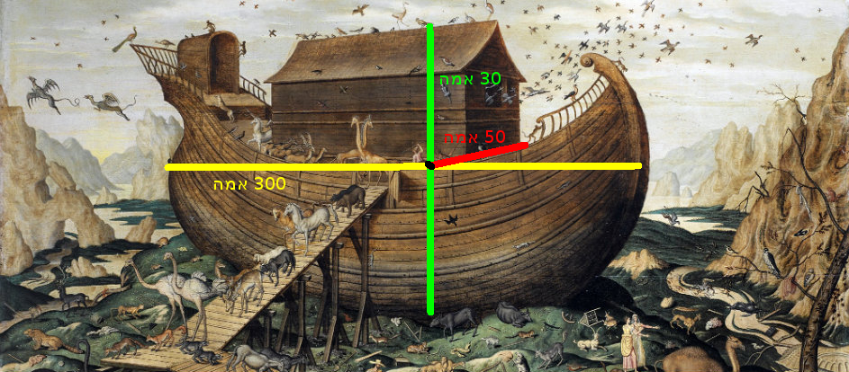
Data Measurement

Slide 5
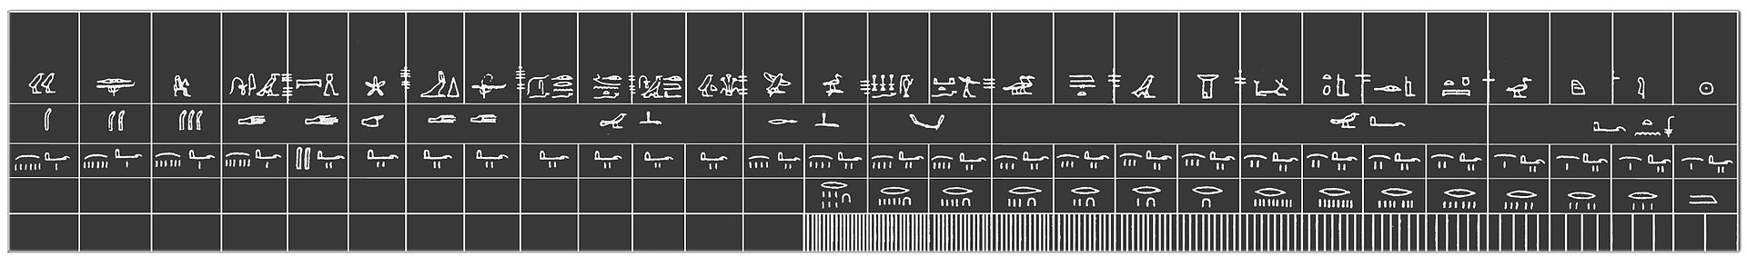
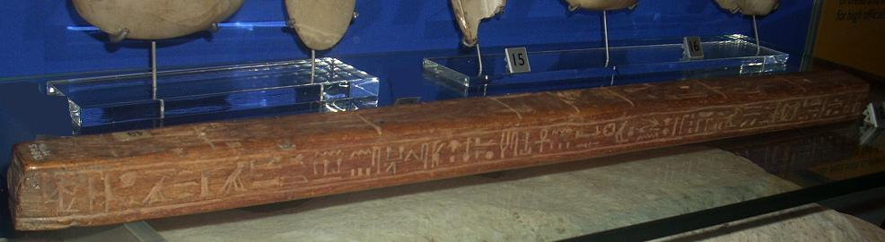
Data Measurement
Egyptian royal cubit

Slide 6
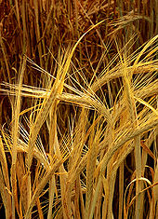
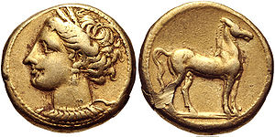
Data Measurement
The earliest recorded systems of weights and measures originate in the 3rd or 4th millennium BC
The need for measurement was driven by agriculture, construction, and trade

Slide 7
Data Measurement
The earliest recorded systems of weights and measures originate in the 3rd or 4th millennium BC
The need for measurement was driven by agriculture, construction, and trade
Every single community or small region developed its own standards for lengths, areas, volumes, masses and time

Slide 8
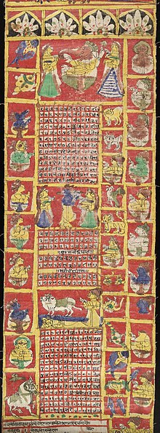
Data Measurement
Time Measurement
Lunar Calendars
Muslim: 29-30d/1m,12m/1y=354/355d
Lunisolar Calendars
Jewish: 29-30d/1m, 12+1m/1y=353/355d
Indian: 30d/1m, 12+1m/1y=360d
Maya: 20d/1m,18m/1y,+5d (wayeb)=360d
Solar Calendars
Gregorian: 28-31d/m, 12m/1y=365/366d

Slide 9
Data Measurement
The earliest recorded systems of weights and measures originate in the 3rd or 4th millennium BC
The need for measurement was driven by agriculture, construction, and trade
Every single community or small region developed its own standards for lengths, areas, volumes and masses
With development of manufacturing technologies, standardized weights and measures became critical

Slide 10
Measurement Units
Unit measurement systems:
Decimal (SI) units
Meters, Hectares, Kilograms, °C (Celsius), seconds
English
Foot, Yards, Pound, °F (Fahrenheit), seconds
Conversion Factors:
Factors used for converting from one unit measure type to another, in the same system or between different systems.

Slide 11
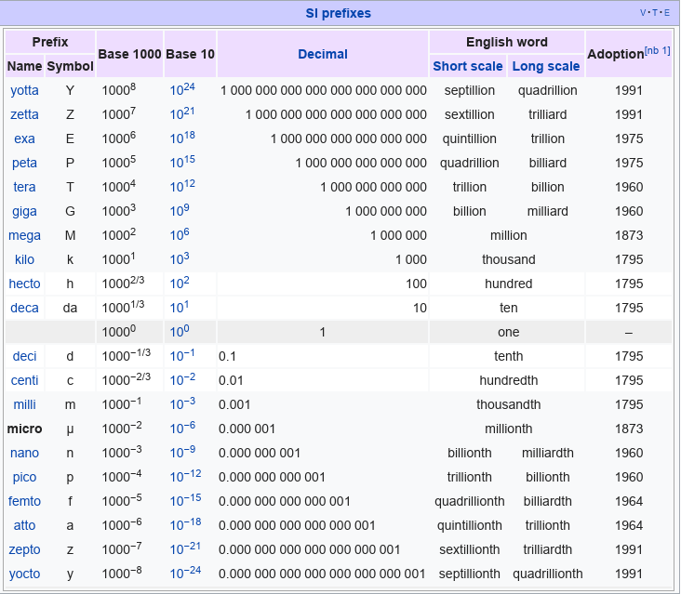
Unit factors
Applies to:
Meter (length)
Gram (weight)
Liter (volume)
Volt (electric pressure)
Ampere (electric current)
Ohm (electric resistance)
Mole (mass)
Bytes (computers)

Slide 12
Measurement errors
Errors on different measures in the same subject/object
Intrinsic differences
Observers differences
Method differences
Imperfect calibration
Units conversion
Notes:
Intrinsic: Blood pressure measure in different positions, Temperature measure in different body parts.

Slide 13
Missing Values
Causes of Missing Data
Input error
Unintentional delete
Measure device problem
Intentional missingness

Slide 14
Missing Values
Missingness classification
Missing completely at random
The distribution of the missing values is the same as that of the non-missing
Missing at random
Systematic differences between the missing and observed values, but these can be entirely explained by other observed variables
Missing not at random
Classification of the missingness allows missing data to be handled in a way that is unbiased and statistically valid

Slide 15
Data Types and Scales
Qualitative (categorical)
Quantitative (numerical)
Discrete
Continuous
Nominal
Ordinal
Interval
Ratio

Slide 16
Data Scales
Nominal
Nominal scale: differentiates between items or subjects based only on their names or (meta-)categories and other qualitative classifications they belong to. A special case is dichotomous data (only two categories). Numbers can be used but their value have no relationships or order relevance.
Ordinal
Continuous
Time-series

Slide 17
Data Scales
Nominal
Ordinal data: is a categorical, statistical data type where the variables have natural, ordered categories and the distances between the categories is not known. Ordinal data could be represented using strings or numbers.
Examples:
Low - Medium - High
Cold - Warm - Hot
Small - Medium - Large
Ordinal
Continuous
Time-series

Slide 18
Data Scales
Nominal
Continuous data scales are a type of data which permits that between two points there are infinite data points.
There are two types of scales with continuous data:
Interval scale
Ratio scale
Ordinal
Continuous
Time-series

Slide 19
Data Scales
Interval scale: is a type of continuous data that allows for the degree of difference between items.
The characteristics of this scale are:
The scale is generated based on two or more relative reference points
The ratios are meaningless
The zero is not absolute
It’s possible to have negative values
Examples:
Temperature, a date since a specific date, geolocation coordinates, calendars. percents, etc
Nominal
Ordinal
Continuous
Time-series

Slide 20
Data Scales
Nominal
Ratio scale: is a type of continuous data that allows for the degree of difference between items.
The characteristics of this scale are:
The scale is the result of measurement using a unit magnitude of the same kind.
The ratios are meaningful
The zero indicate absence of the entity being measured (absolute zero)
Negative values are not possible, but sometimes used to indicate direction
Ordinal
Continuous
Time-series

Slide 21
Data Scales
Nominal
Time-series data: is a type of data that is intrinsically associated to a timestamp. The values measured may be continuous, but are not independent and may be influenced on previous values.
Ordinal
Continuous
Time-series

Slide 22
Data Scales
Incremental progress | Measure property | Mathematical operators | Advanced operations | Central tendency
Nominal | Classification, membership | =, ≠ | Grouping | Mode
Ordinal | Comparison, level | >, < | Sorting | Median
Interval | Difference, affinity | +, − | Yardstick | Mean, Deviation
Ratio | Magnitude, amount | ×, / | Ratio | Geometric mean, Coefficient of variation

Slide 23
Data Types & Scales
Data type | Nominal | Ordinal | Interval | Ratio | Time-series
Char | ✓ | ✓ | ✘ | ✘ | ✘
Varchar | ✓ | ✓ | ✘ | ✘ | ✘
Text | ✓ | ✓ | ✘ | ✘ | ✘
Integer | ✓ | ✓ | ✓ | ✓ | ✓
Decimal | ✘ | ✘ | ✓ | ✓ | ✓
Float | ✘ | ✘ | ✓ | ✓ | ✓
Boolean | ✓ | ✘ | ✘ | ✘ | ✘
DateTime | ✘ | ✘ | ✘ | ✘ | ✓

Slide 24
Variable Description
Name | Value type | Scale | Data type | Unique count | Measure unit | Conversion factor | Min | Max | Outlier treatment | Null | Notes
Age | Numeric | Ratio | Int | -- | years | -- | 18 | 70 | NA | NA
AgeGrp | Category | Ordinal | Int | 3 | -- | -- | 1 | 3 | NA | NA | 1=18-30 2=31-50 3=51-70
Sex | Category | Nominal | Int | 2 | -- | -- | 1 | 2 | NA | NA | 1=M 2=F
Temperature | Numeric | Interval | Float | -- | ͒C (celcius) | -- | 35.0 | 42.0 | NA | NA
Birth year | Date | Year | int | 53 | -- | -- | 1947 | 1999 | NA | NA
Occupation | Category | Nominal | Varchar | 25 | -- | -- | -- | -- | Blank | Blank
Income | Money | Ratio | Decimal | -- | Dollar | NIS/3.65 Euro*0.67 | 0 | 99999 | 0 | NA

